Slide 1



Harnessing Data Insights for Proactive Security
By : Aarti Ramani
Date : 09/22/2023
Notes:
Hi Everyone, I am Aarti Ramani and today we are going to explore the critical realm of credit card transaction security and the approaches we're taking to safeguard financial well-being.

Slide 2
INTRODUCTION
A pressing issue that has been plaguing businesses and financial institutions across the globe is the relentless growth of credit card fraud. This formidable challenge has compelled us to explore effective solutions that can not only detect but also prevent fraudulent transactions in real-time.
This project embarks on a journey to harness the power of machine learning to construct a robust credit card fraud prediction system. This system's primary objective is to draw a clear line between legitimate and fraudulent credit card transactions.
Notes:
Today we confront a growing menace affecting businesses worldwide – the relentless surge of credit card fraud. This challenge compels us to seek innovative solutions that not only detect but also prevent fraudulent transactions in real time. This project embarks on an transformative journey, leveraging the power of machine learning to build a robust credit card fraud prediction system. The primary objective is to draw a clear line between legitimate and fraudulent credit card transactions.
In doing so, we aim to achieve several key goals: fortify security measures, reduce false positives that can cause unnecessary inconvenience to customers, enhance the overall customer experience, and most importantly, stay one step ahead of the ever-evolving tactics employed by fraudsters.

Slide 3
PROCESS
The process flow of this project is as follows:
Data Preparation
(Cleansing & Transformation)
Data Collection
Exploratory Data Analysis
Model Building and Training
Model Evaluation
Notes:
This slide outlines the project process flow. We'll delve into each step in upcoming slides.

Slide 4
DATA SOURCE (Collection)
The dataset used in this project is sourced from Kaggle by
Shenoy, K. (2020, August 5)), a public-domain dataset.
This dataset contains stimulated credit card data with legitimate and fraudulent credit card transactions from Jan 2019 to Dec 2020.
Notes:
The dataset for the project is from Kaggle. It includes simulated credit card data, featuring both legitimate and fraudulent transactions, with attributes like transaction amounts, timestamps, merchant details, geographic data, and cardholder information

Slide 5
DATA PREPARATION
The following steps were performed to prepare the data for modelling.
i. Checked for null rows/columns in the data.
ii. Performed check for duplicates.
iii. Converted datetime string to a datetime datatype.
iv. Added a month column for visualization.
v. Dropped columns (‘Unnamed: 0' and 'trans_date_trans_time’)
Notes:
Here, we see the different data preparation steps implemented in the project. Checks such as empty rows, duplicate rows, datetime conversions etc. are certain data transformation steps performed.

Slide 6
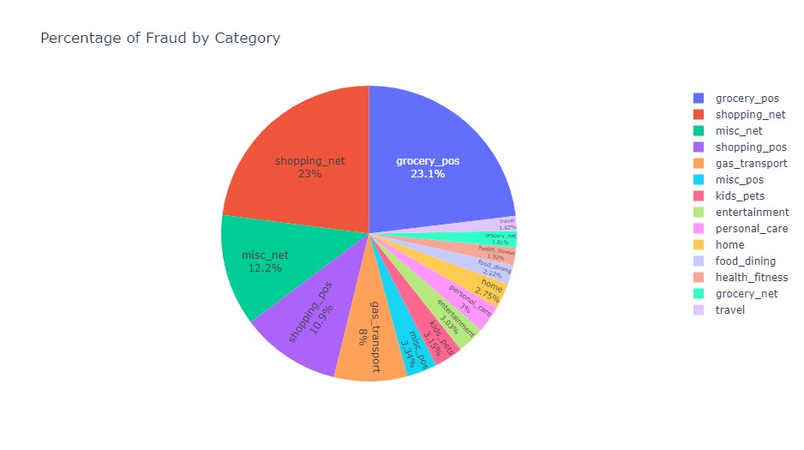
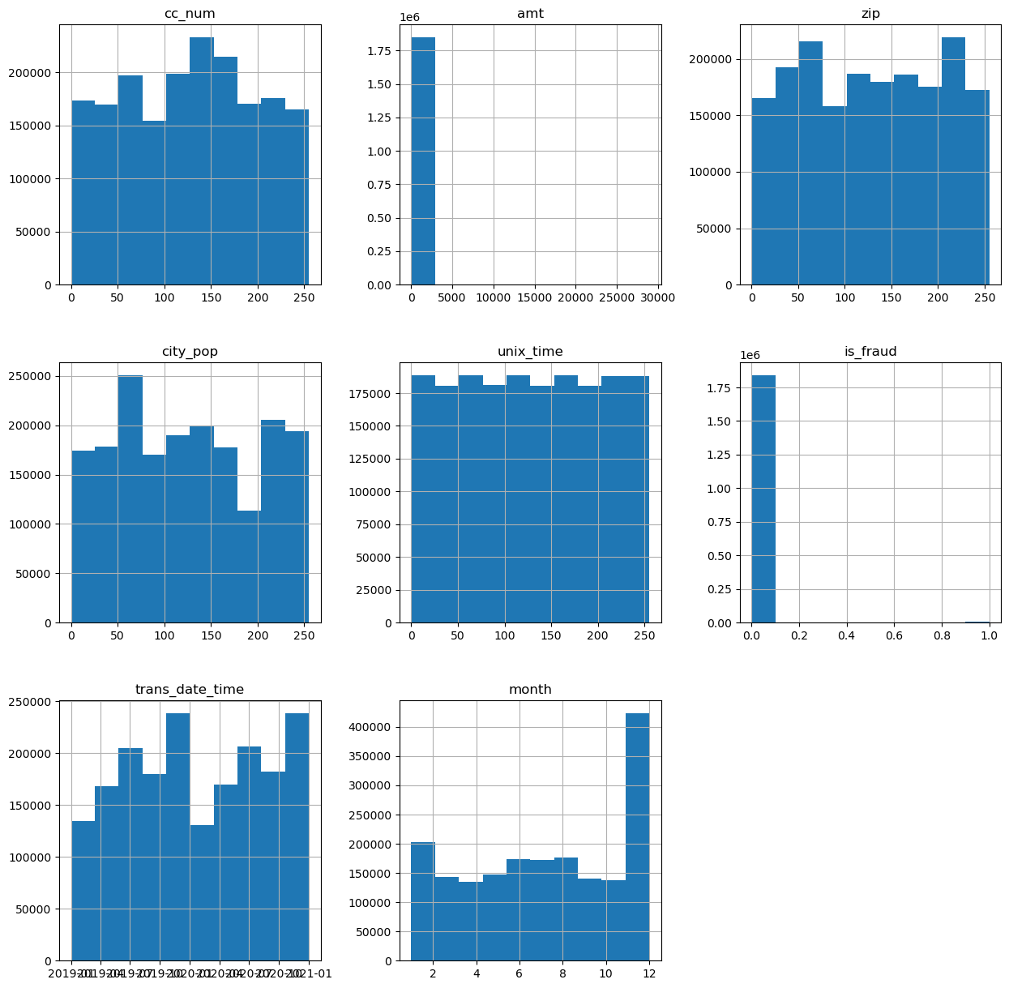
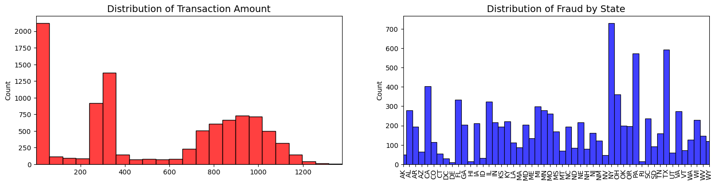
EXPLORATORY DATA ANALYSIS
Notes:
This slide showcases various visualizations created from our dataset.
A pie chart illustrating frauds by category.
A chart displaying the distribution of transaction amounts and the number of frauds per state.
The third visualization showcases the distribution of numeric fields in the dataset."

Slide 7
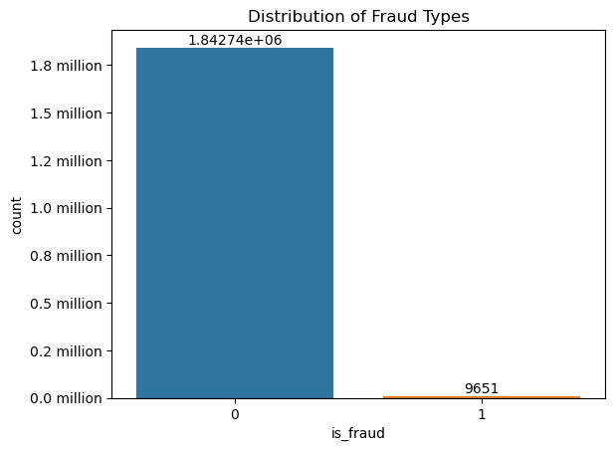
MODEL BUILDING & TRAINING
To construct an effective model, it is essential to address the dataset's imbalance. To achieve this, the Synthetic Minority Oversampling Technique (SMOTE) was employed. With the balanced dataset, the subsequent step was to partition the data into training and testing datasets.
Notes:
There was an initial class imbalance, with more non-fraud transactions than fraudulent ones, reflecting real-time scenarios. To address the imbalance, the Synthetic Minority Oversampling Technique (SMOTE) was employed to balance the dataset.
Additionally, given the dataset's categorical features, a Label Encoder was utilized to convert them into numerical format, and the StandardScaler preprocessing technique was applied to standardize or normalize numerical features.

Slide 8
The following models were developed, with their respective outcomes recorded.
Random Forest Classifier
Using a Random Forest model for credit card fraud detection offers benefits like ensemble learning, robustness against noise and outliers, handling imbalanced data, and capturing complex patterns. Its ability to handle non-linearity, easy tunability, and feature importance analysis make it a strong choice.
Pros: Ensemble learning, robustness, handles imbalanced data, captures complex patterns.
Logistic Regression
Using a Logistic Regression model for credit card fraud detection has benefits including interpretability, computational efficiency, and suitability for smaller datasets. It provides insights into feature impacts, acts as a baseline, and offers transparent probability estimations. However, its linear nature might limit performance on complex, non-linear data patterns.
Pros: Interpretable, efficient, suitable for smaller datasets.
Cons: Limited performance on complex, non-linear data.
Gradient Booster
Gradient Boosting is a powerful method for credit card fraud detection due to its high predictive accuracy, ensemble nature that reduces overfitting, and the ability to handle complex patterns in the data. It also offers insights into feature importance, aiding in identifying relevant variables for fraud detection.
Pros: High predictive accuracy, reduces overfitting, handles complex data patterns.
Neural Network
Neural Network (NN) models offer advantages in credit card fraud detection due to their ability to capture intricate non-linear patterns in data. They excel in feature learning from raw data, making them adept at detecting complex and evolving fraud behaviors.
Pros: Captures intricate non-linear patterns, adept at detecting complex fraud behaviors.
Notes:
In this project, we built the Random Forest Classifier, Logistic Regression, Gradient Booster, and Neural Network models. This slide presents an overview of each model and its advantages and disadvantages. We'll delve into the outcomes of each model in the upcoming slides.

Slide 9
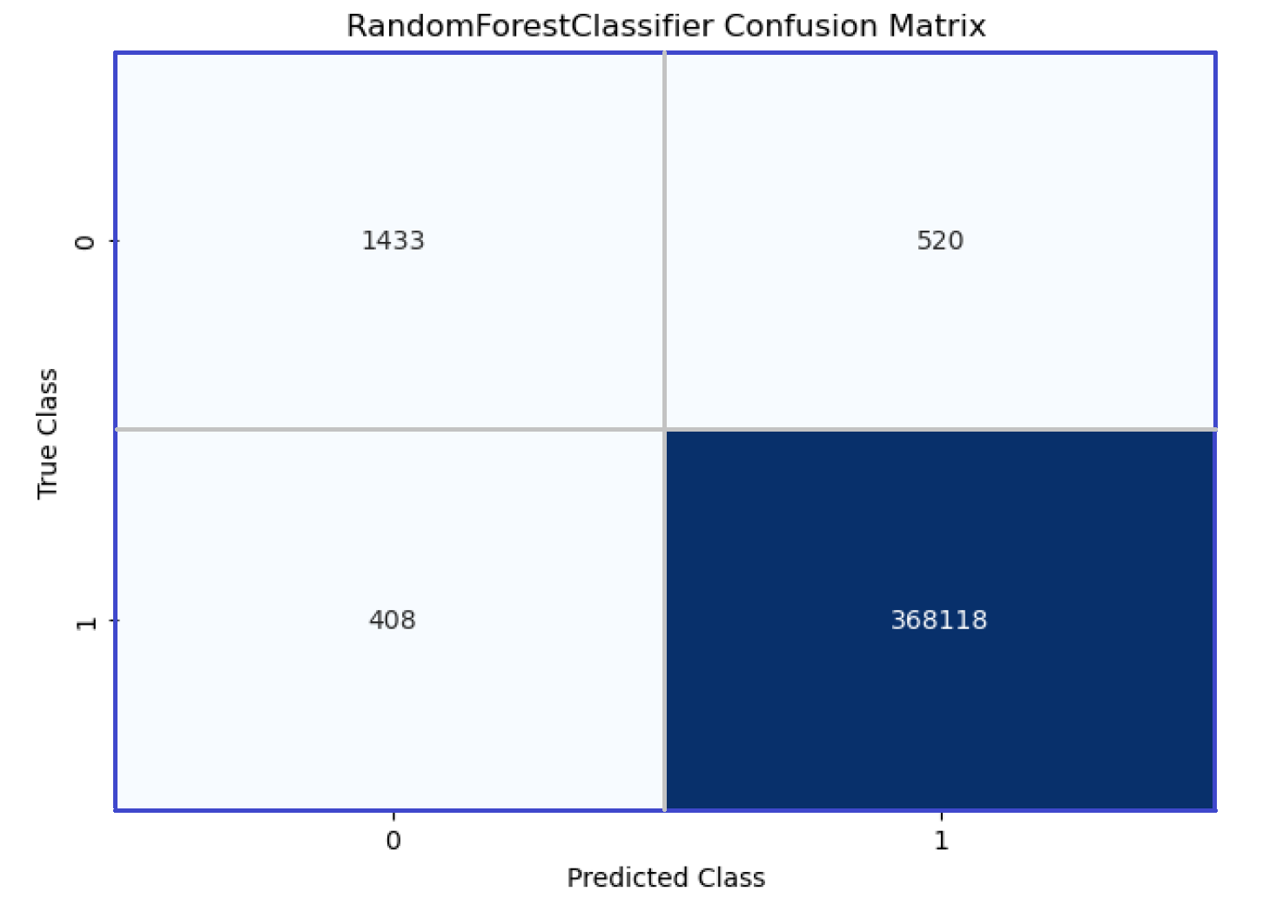
MODEL EVALUATION
Random Forest Classifier
Fraud Type | Precision | Recall | F1-Score
0 – non-Fraud | 1.00 | 1.00 | 1.00
1 - Fraud | 0.79 | 0.72 | 0.75
Accuracy | ROC-AUC Score
99.75% | 0.86
Notes:
Random Forest Classifier:
Based on the recall, we can say that the model correctly identifies 72% of actual fraud cases.
A ROC-AUC score of 0.86 suggests that the model has a strong ability to discriminate between non-fraudulent and fraudulent transactions.
The confusion matrix provides a detailed breakdown of the model's predictions. It shows that the model correctly classified 368,118 non-fraudulent transactions (True Negatives) and 1,433 fraudulent transactions (True Positives). It also misclassified 408 non-fraudulent transactions as fraudulent (False Positives) and 520 fraudulent transactions as non-fraudulent (False Negatives).

Slide 10
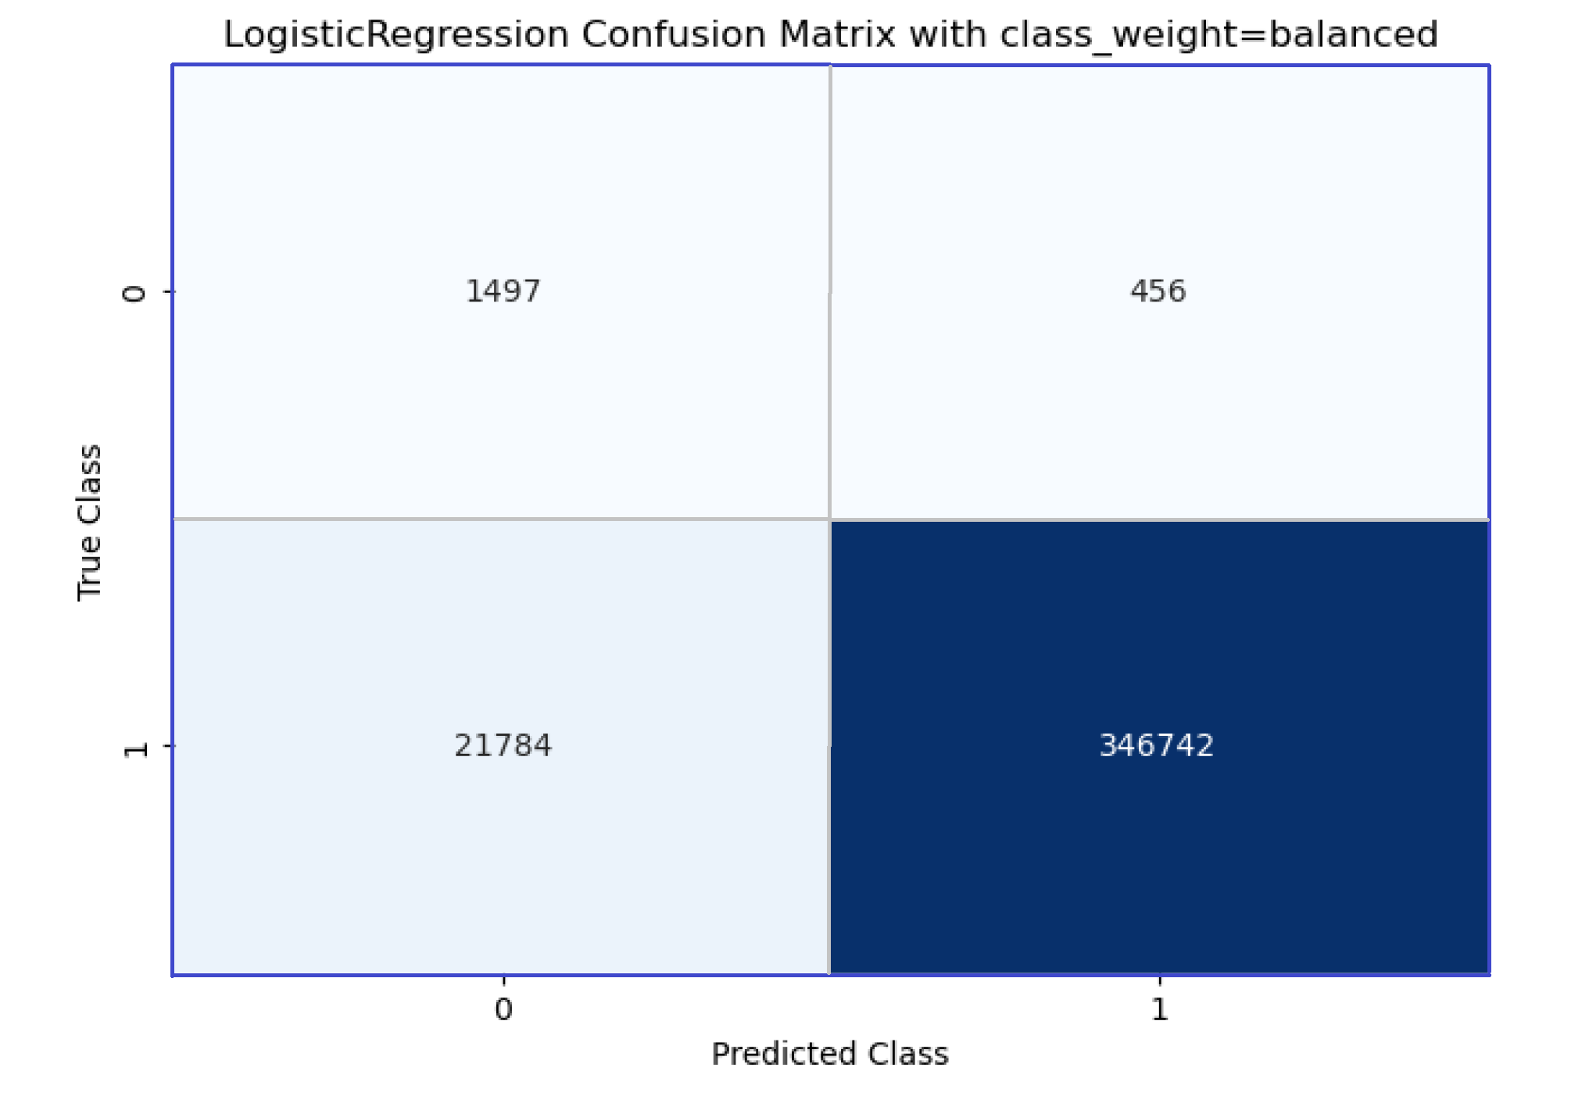
Logistic Regression
Fraud Type | Precision | Recall | F1-Score
0 – non-Fraud | 1.00 | 0.94 | 0.97
1 - Fraud | 0.06 | 0.77 | 0.12
Accuracy | ROC-AUC Score
93.99% | 0.85
Notes:
Logistic Regression:
The Logistic Regression model correctly identifies about 94% of all actual non-fraudulent transactions and 77% of actual fraud cases.
A ROC-AUC score of 0.85 indicates a relatively good ability to discriminate between non-fraudulent and fraudulent transactions.
Confusion Matrix:
The confusion matrix shows that the model correctly classified 346,742 non-fraudulent transactions (True Negatives) and 1,497 fraudulent transactions (True Positives). However, it also misclassified 21,784 non-fraudulent transactions as fraudulent (False Positives) and 456 fraudulent transactions as non-fraudulent (False Negatives).

Slide 11
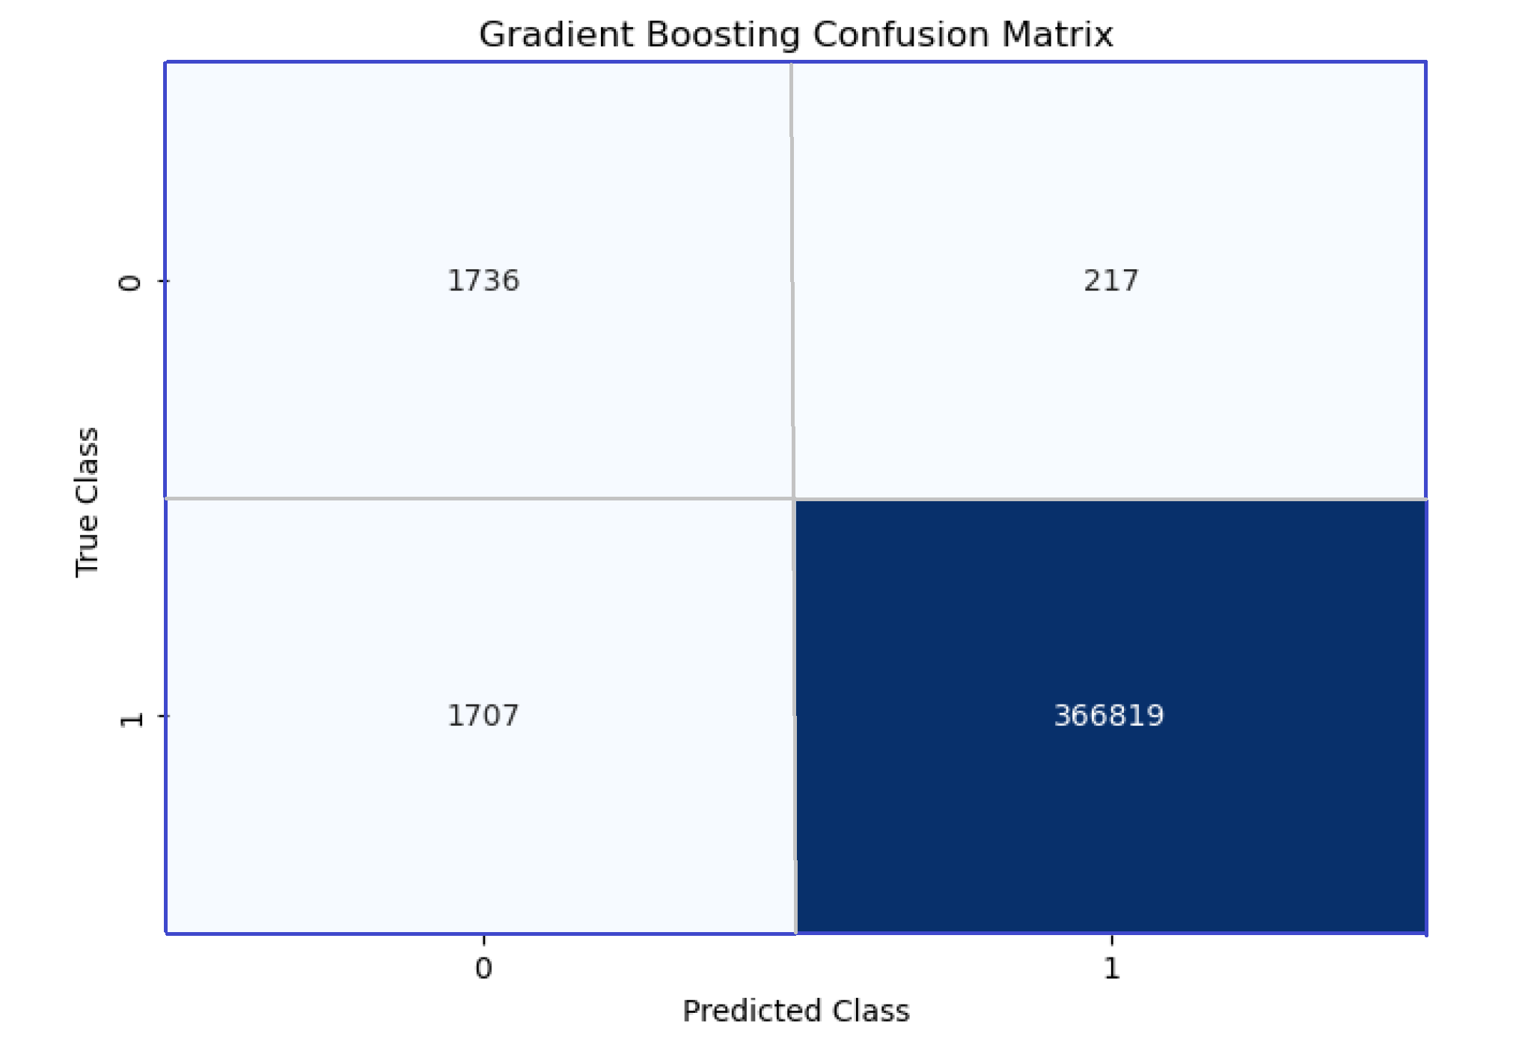
Gradient Boosting
Fraud Type | Precision | Recall | F1-Score
0 – non-Fraud | 1.00 | 1.00 | 1.00
1 - Fraud | 0.50 | 0.89 | 0.64
Accuracy | ROC-AUC Score
99.4% | 0.94
Notes:
Gradient Boosting:
The model correctly identifies about 89% of all actual fraud cases.
A ROC-AUC score of 0.94 is excellent and indicates a strong ability to discriminate between non-fraudulent and fraudulent transactions.
The confusion matrix shows that the model correctly classified 366,819 non-fraudulent transactions (True Negatives) and 1,736 fraudulent transactions (True Positives). It misclassified 1,707 non-fraudulent transactions as fraudulent (False Positives) and 217 fraudulent transactions as non-fraudulent (False Negatives).

Slide 12
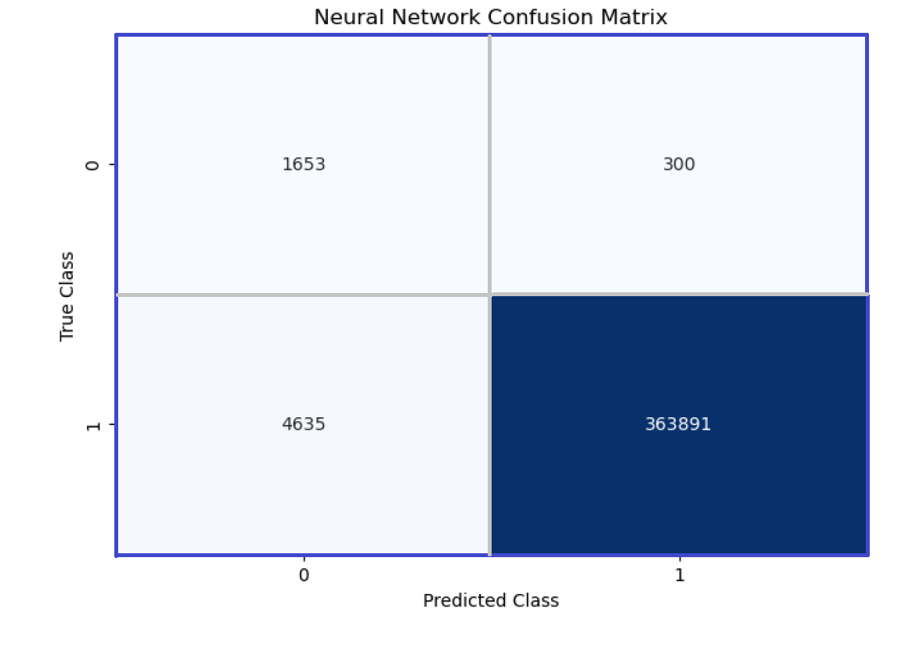
Neural Network
Fraud Type | Precision | Recall | F1-Score
0 – non-Fraud | 1.00 | 0.99 | 0.99
1 - Fraud | 0.26 | 0.75 | 0.38
Accuracy | ROC-AUC Score
98.7% | 0.87
Notes:
Neural Network:
The model correctly identifies about 75% of all actual fraud cases.
A ROC-AUC score of 0.87 is good and indicates a reasonable ability to discriminate between non-fraudulent and fraudulent transactions.
The confusion matrix shows that the model correctly classified 363,891 non-fraudulent transactions (True Negatives) and 1,653 fraudulent transactions (True Positives). However, it also misclassified 4,635 non-fraudulent transactions as fraudulent (False Positives) and 300 fraudulent transactions as non-fraudulent (False Negatives).

Slide 13
ETHICAL IMPLICATIONS
Several ethical considerations are crucial for this project:
Data Privacy: Despite the simulation, safeguarding privacy is essential. Ensuring simulated data does not resemble real customer information avoids accidental exposure of PII (Appendix (i)).
Informed Consent: Transparency builds trust and addresses concerns. Understanding if consent was obtained for real-based simulations, even if anonymized, adds ethical integrity.
Intent and Use: Ethical utilization of simulated data is paramount, prohibiting any malicious or harmful intent.
Data Security: Robust security measures should be applied to the simulated dataset, treating it with the same importance as real customer data.
Stakeholder Implications: The viewpoints of stakeholders like credit card issuers, customers, and regulators to ensure ethical alignment should be considered.
Notes:
ETHICAL IMPLICATIONS:
With Credit card data, it is paramount to consider ethical implications such as Data privacy, transparency, and security. It is essential to use simulated data for positive purposes, with no harmful intent. Additionally, it is important to actively engage with stakeholders to ensure alignment with ethical standards and expectations.

Slide 14
CONCLUSION
In conclusion, our journey to fight credit card fraud has been enlightening. We explored various machine-learning techniques to build robust fraud detection systems.
The Random Forest Classifier performed best with an impressive 99.75% accuracy.
Model | Random Forest Classifier | Logistic Regression | Gradient Booster | Neural Network
Accuracy | 99.75% | 93.99% | 99.4% | 98.7%
Notes:
CONCLUSION:
In summary, this project focused on developing and implementing effective credit card fraud detection models. We explored various machine-learning techniques, such as logistic regression, random forest classifier, gradient boosting, and neural networks.
With an accuracy of 99.75%, the Random Forest Classifier is the best-performing model for this dataset. However, the dataset is highly imbalanced, with a significantly larger number of non-fraudulent transactions. This can impact the model's performance and interpretation of metrics.
While all three models demonstrated high accuracy and strong performance in identifying non-fraudulent transactions, there is a trade-off between precision and recall for detecting fraudulent transactions.

Slide 15
REFERENCES
Shenoy, K. (2020, August 5). Credit Card Transactions Fraud Detection Dataset.
Kaggle - https://www.kaggle.com/datasets/kartik2112/fraud-detection?select=fraudTrain.csv
Jennifer Watkins, ARC’s Director, Credit Card Services & Fraud Prevention, and Christophe Kato, IATA’s Head of Payment Services. (2020, August 5). Credit Card Transactions Fraud Detection Dataset. (2018, September 3)
Preventing credit card fraud can reduce chargeback ADMs - https://airlines.iata.org/sites/default/files/migrated/airlines/airlines/analysis-preventing-credit-card-fraud-ca--web-fraud-prevention-istock-155354133-20.png

Slide 16
THANK YOU!
Notes:
Thank you all for joining me in this presentation. I hope this project was able to aid in the understanding of the efforts to enhance credit card transaction security. If you have any questions or insights, please feel free to share them. Thank you.

